Slide 1
Definitions and Characteristics of Different Business Ecosystem Types, and Identification of Suitable Visualization Tools
Maximilian Riemhofer, 08. February 2019, Bachelor Thesis - Kick-Out-Presentation

Slide 2
Outline
Business Ecosystems
  Motivation
  Research Questions
Business Ecosystem Theory
  Systematic Mapping Study
  Working Definition
Business Ecosystem Variations
  Types
  Structures
  Types vs. Structures
Business Ecosystem Visualization
  Approach
  Results
Summary of Results
Sources

Slide 3



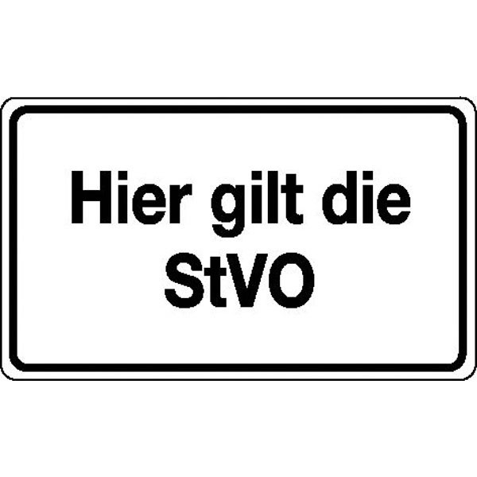
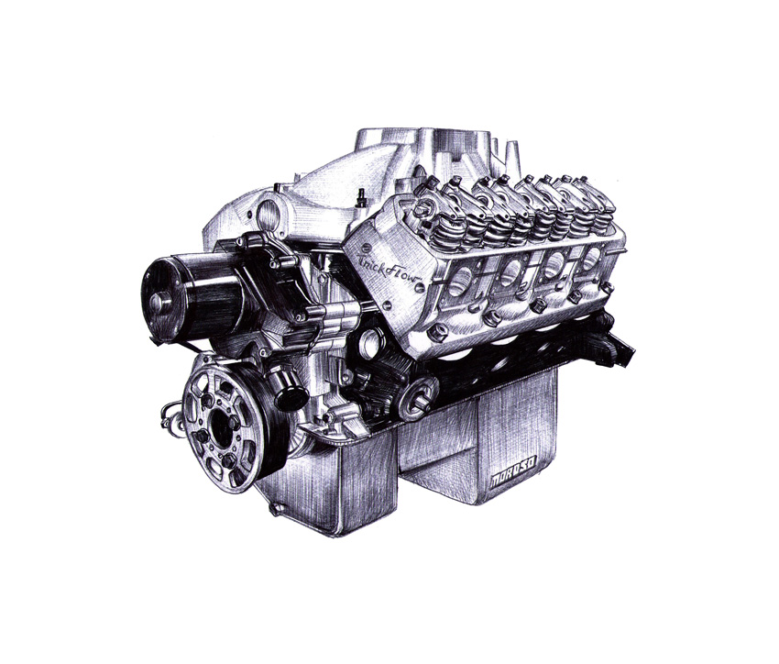

Business Ecosystems - Motivation
https://sketchb4.files.wordpress.com/2013/02/bmw-5-series-gran-turismo-concept-sketch-img_1.jpg
https://s-media-cache-ak0.pinimg.com/originals/05/73/b3/0573b3780afbb356256fc712c33701a1.jpg
http://www.clipartkid.com/images/397/microscope-drawing-clipart-panda-free-clipart-images-J24M4k-clipart.jpg
http://www.tirestoo.com/wp-content/uploads/2015/10/car-tires.png
http://fc02.deviantart.net/fs71/f/2013/340/4/3/untitled_by_taucf-d6wxzil.jpg
https://www.wolkdirekt.com/images/600/115692/verkehrsschild-betriebskennzeichnung-hier-gilt-die-stvo.jpg
Based on [1] – [5]
Notes:
Car consists of more than 10.000 single pieces. Examples:
Lighting systems
Tires
Engine and components
Supply Chain
More aspects need to be considered
Other related areas:
Rules for driving (rules, infrastructure)
Research and innovation (more efficient engines, electric vehicles)

Slide 4






Business Ecosystems - Motivation
https://upload.wikimedia.org/wikipedia/commons/thumb/4/44/BMW.svg/1200px-BMW.svg.png
http://dss.in.tum.de/templates/dsstemplate3/images/TUM_Logo_extern_ot_RGB_neg_p.png
http://www.sz-ybbs.ac.at/~sz-ybbs/typo3temp/_processed_/csm_Zizala_Logo_579b70fd9f.jpg
https://cdn.freebiesupply.com/logos/thumbs/2x/bosch-logo.png
http://logok.org/wp-content/uploads/2014/06/Bridgestone-logo-old.png
http://www.gamersglobal.de/sites/gamersglobal.de/files/news/teaser/14943/2000px-Die_Bundesregierung_Logo.svg_.png
Based on [1] – [5]
Notes:
Same ecosystem, but with companies rather than pieces

Slide 5
Business Ecosystems - Research Questions
Several definitions for business ecosystems
RQ1: Which definitions of business ecosystems already exist in literature, and what commonalities and differences can be identified?
Business Ecosystems
Different variations of business ecosystems
RQ2: What are specific types of business ecosystems in literature, and how can the be categorized?
Business ecosystems and visual analytics
RQ3: What are existing modeling and visualization tools, and how well-suited are they for the identified types of business ecosystems?
Notes:
RQ1: list all definitions, but set focus of the paper on one
RQ2: identification of different types, their similarities and differences
RQ3: visualization(s / tools) for the types of BE identified in RQ2

Slide 6
Outline
Business Ecosystems
  Motivation
  Research Questions
Business Ecosystem Theory
  Systematic Mapping Study
  Working Definition
Business Ecosystem Variations
  Types
  Structures
  Types vs. Structures
Business Ecosystem Visualization
  Approach
  Results
Summary of Results
Sources

Slide 7
Business Ecosystem Theory – Systematic Mapping Study
Phase 1
Phase 2
Phase 3
List with results for further refinement
Content Mapping Matrix and refined list with results
Suitable Queries
Read relevant results from Phase 1
Backward Citations
List with relevant results
Querying Databases
118 + 18
= 136
1,842
118
Title, abstract, keywords
382
Forward Citations
Duplicate elimination
258
adapted from [6] - [9]
Notes:
Systematic Mapping Study
Budgen et al.
Petersen et al.
Kitchenham et al.
Webster and Watson

Slide 8
Business Ecosystem Theory – Content Mapping Matrix
RQ 1
RQ 1
RQ 1
RQ 2
RQ 3
Record | BE Definition | BE Roles | BE Phases | BE Types | BE Visualization | BE Application | BE Example | BE Central Topic
… | … | … | … | … | … | … | … | …
Adner2006 |  |  |  | X |  |  | X | (X)
BasoleEtAl2015 | X |  |  |  | X | X | X | X
Giesecke2014 |  | X |  |  |  | X |  | (X)
IansitiLevien2004 | X | X | X | X |  | X | X | X
Moore1996 | X | X | X |  |  | X | X | X
RongShi2014 | X | X | X | X |  | X | X | X
Sako2018 |  |  |  | X |  |  |  | (X)
YangEtAl |  |  | X |  |  |  | X
… | … | … | … | … | … | … | … | …
adapted from [6] - [9]
Notes:
Content Mapping Matrix example
Describe categories
Difference between X, (X), and no X

Slide 9
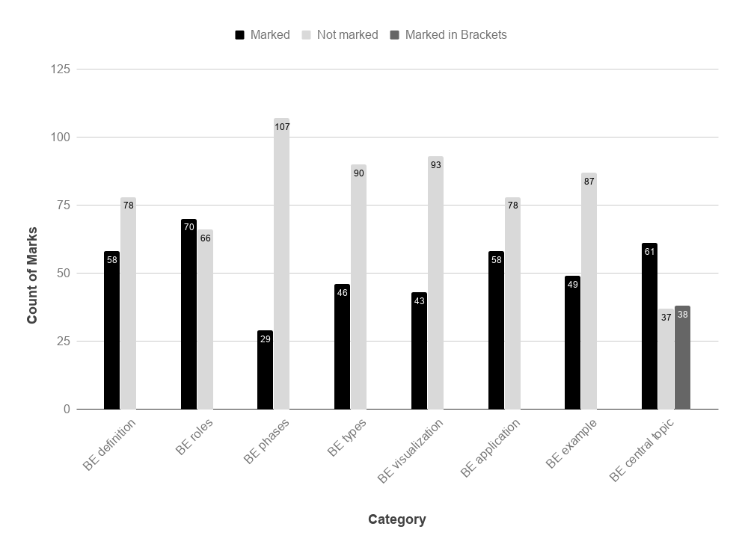
Business Ecosystem Theory – Category Distribution
Notes:
Result of Content Mapping Matrix
Highest figures: BE roles, definition, application
Lowest figures: BE visualization , phases

Slide 10
Business Ecosystem Theory – Working Definition
Business Ecosystem Definitions
Working Definition
29
Notes:
Synthesizing different definitons into a working definition

Slide 11
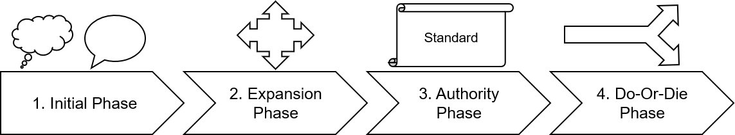
Business Ecosystem Theory – Working Definition
Network of different entities from multiple industries
Complex relationships between them
Different roles: leaders and followers
Evolution over time
Business Ecosystem
Extended Enterprise
Core Business
Key:
Keystone
Niche Player
Adapted from [3] – [5]
Notes:
Working Definition of Business Ecosystems:
Network of different entities from multiple industries
Difference to supply chain and similar concepts
Complex relationships between them
Different roles
Leaders: keystones and dominators (explain later)
Followers: niche players
→ Layer-Framework by James F. Moore
Evolution over time
Initial phase: development of idea and first contributors
Expansion phase: more and more contributors, start of competition between ecosystems
Increased competition between ecosystems for dominant design/standard in the market
Do-or-Die phase: either innovation and self-renewal or death

Slide 12
Outline
Business Ecosystems
  Motivation
  Research Questions
Business Ecosystem Theory
  Systematic Mapping Study
  Working Definition
Business Ecosystem Variations
  Types
  Structures
  Types vs. Structures
Business Ecosystem Visualization
  Approach
  Results
Summary of Results
Sources

Slide 13
Business Ecosystem Variations – Types
Platform Business Ecosystem
Family Spin-Off Business Ecosystem
Digital Business Ecosystem
Mobile/Internet Business Ecosystem
Business Ecosystem Types
Start-Up Business Ecosystem
Customer-centric Business Ecosystem
Innovation Ecosystem
Software Ecosystem (SECO)
Mobility Business Ecosystem
IoT Business Ecosystem
Notes:
Platform Ecosystem:
builds around a Platform
Example: Apple‘s App Store
Innovation Ecosystem & Start-Up Business Ecosystem:
inovativ idea for product or service is key driver of the BE
vs.
entrepreneur/start-up is keystone of the BE
Family-Spin-Off Business Ecosystem:
Extending the boundaries from a family organizational perspective
spin-off leader of the ecosystem
→ Core Business only difference from Working Definition

Slide 14
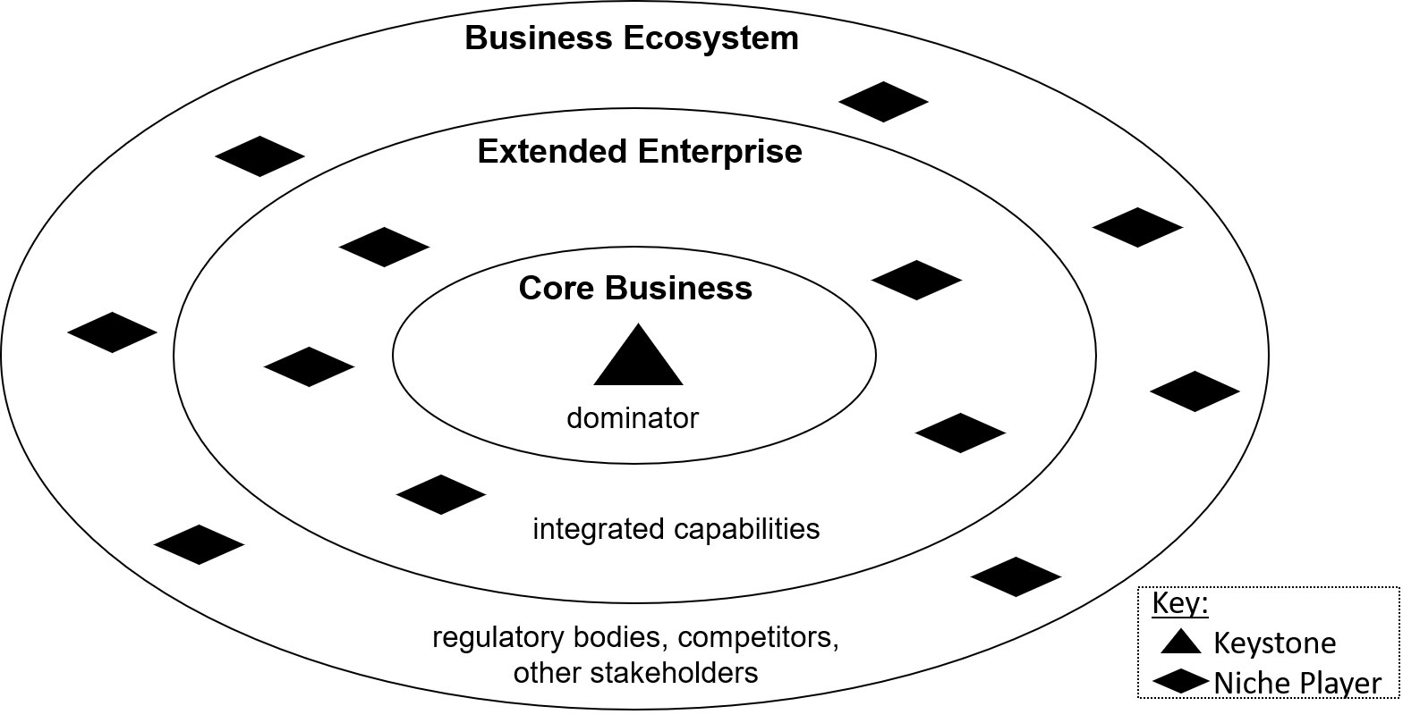
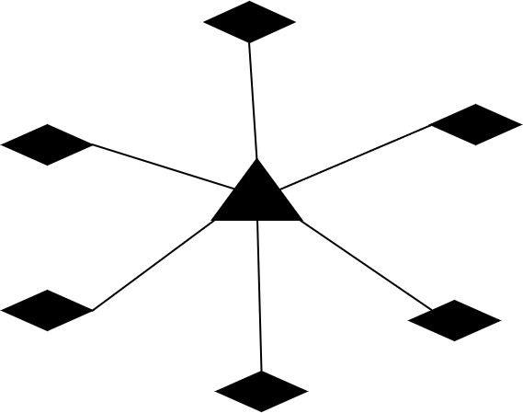
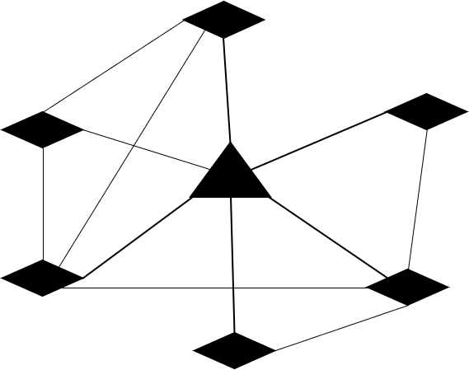
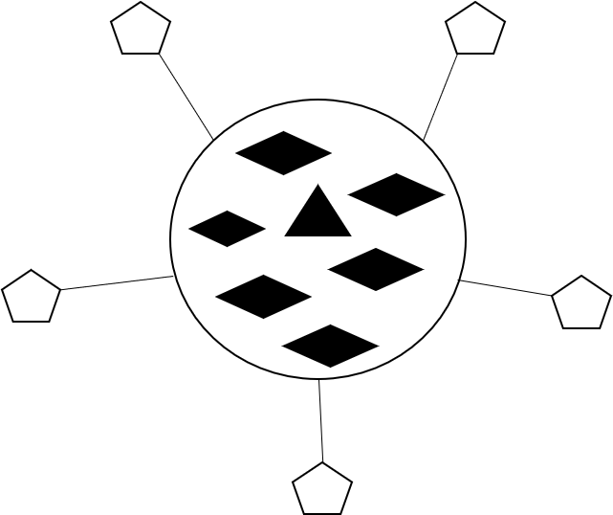
Business Ecosystem Variations – Structures
Dominator Strategy
Business Ecosystem Structures
Established Center
Keystone Strategies
Networked Structure
No Centralized Leadership
Notes:
Structures depend on strategy:
Dominator strategy: integrate all necessary capabilities
Keystone strategy: network and bind capabilities to own ecosystem
Depict evolution of a BE

Slide 15
Business Ecosystem Variations – Types vs. Structures
Business Ecosystem Working Definition
Business Ecosystem Types
Business Ecosystem Structures
Center
Core contributors
Distribution channels
Direct suppliers
Differs for each types
Keystone(s) or Dominator
Roles
Keystone(s)/Dominators and Niche Players. Specific Contributors vary depending on the core value.
Each structure represents one evolutionary phase
Evolution
Notes:
Similarities and differences between Working Definition, BE Types, and BE Structures

Slide 16
Outline
Business Ecosystems
  Motivation
  Research Questions
Business Ecosystem Theory
  Systematic Mapping Study
  Working Definition
Business Ecosystem Variations
  Types
  Structures
  Types vs. Structures
Business Ecosystem Visualization
  Approach
  Results
Summary of Results
Sources

Slide 17
Business Ecosystem Visualization - Approach
Notes:
Only 26 records discuss BE visualization → aim to fill this gap

Slide 18

Business Ecosystem Visualization - Approach
Business Ecosystem:
Definitions
Types
Visualizations and Tools
Additional Visualizations and Tools
Criteria for suitable visualization tools
Existing BE Visualization Tools
Recommendations of Visualizations and Visualization Tools
Visual Analytics: Categorization of Visualizations (Shneiderman [10])
Visualizations used in the Literature
Visuals used for BE Types
Notes:
Process Model of BE Visualization Analysis:
Definitions, Types, and some visuals/tools through Mapping Study
Additional information via Internet search
Incorporating visual analytics by using Shneidermans visualization classification
How were BEs and BE Types visualized in the literature?
Analysis of existing BE visualization tools
Extract criteria for suitable visualization tools
→ Recommendations

Slide 19
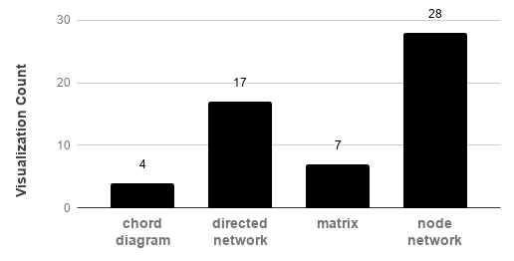
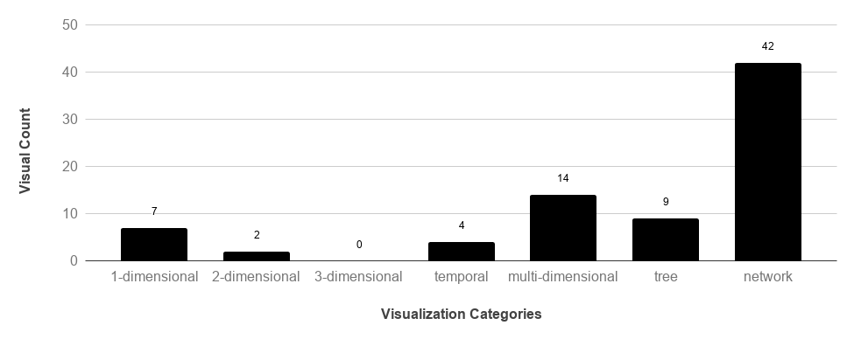
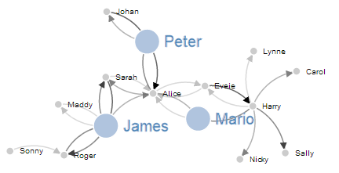
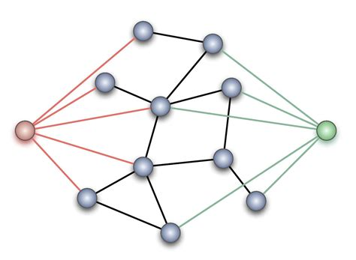
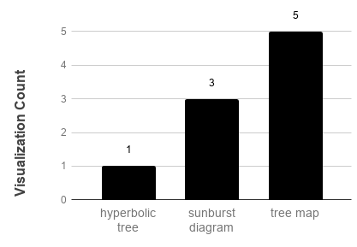
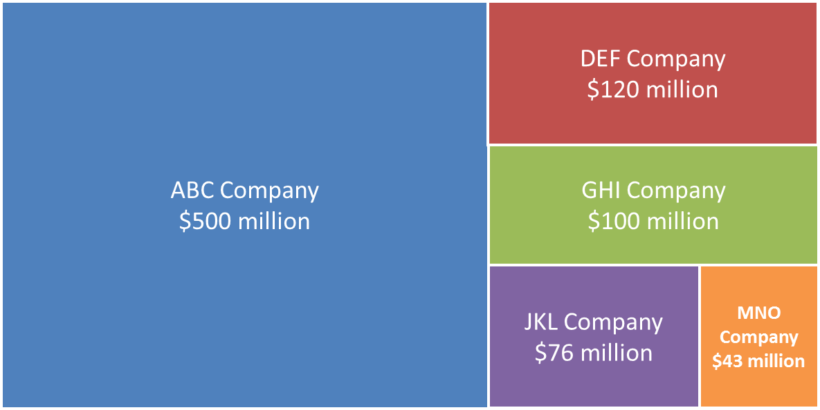
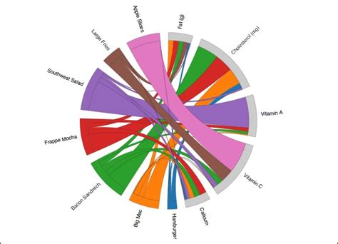
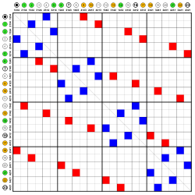
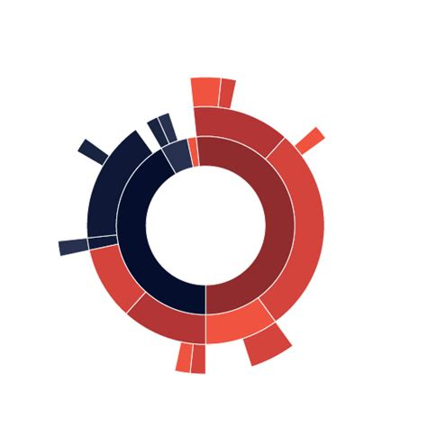
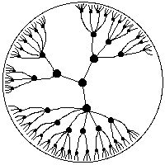
Business Ecosystem Visualization - Results
Directed Network
Node Network
Tree Map
Chord Diagram
Matrix
Sunburst Diagram
Hyperbolic Tree
URLs of the images on slide 26
Notes:
Visualization categories by Shneiderman (see graphic top left)
Network visualizations most frequently used, in all viz records
Additional information depicted by the other categories
Depiction of those viz used in the literature

Slide 20
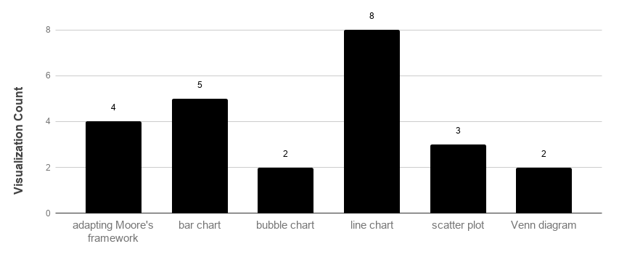
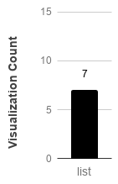
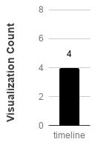
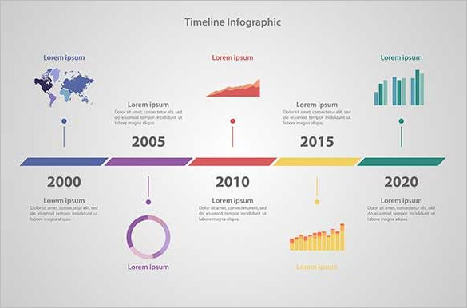

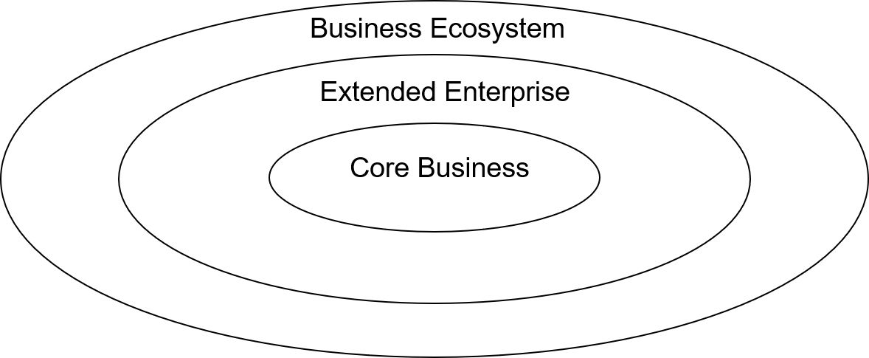
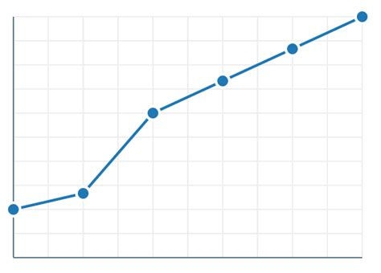
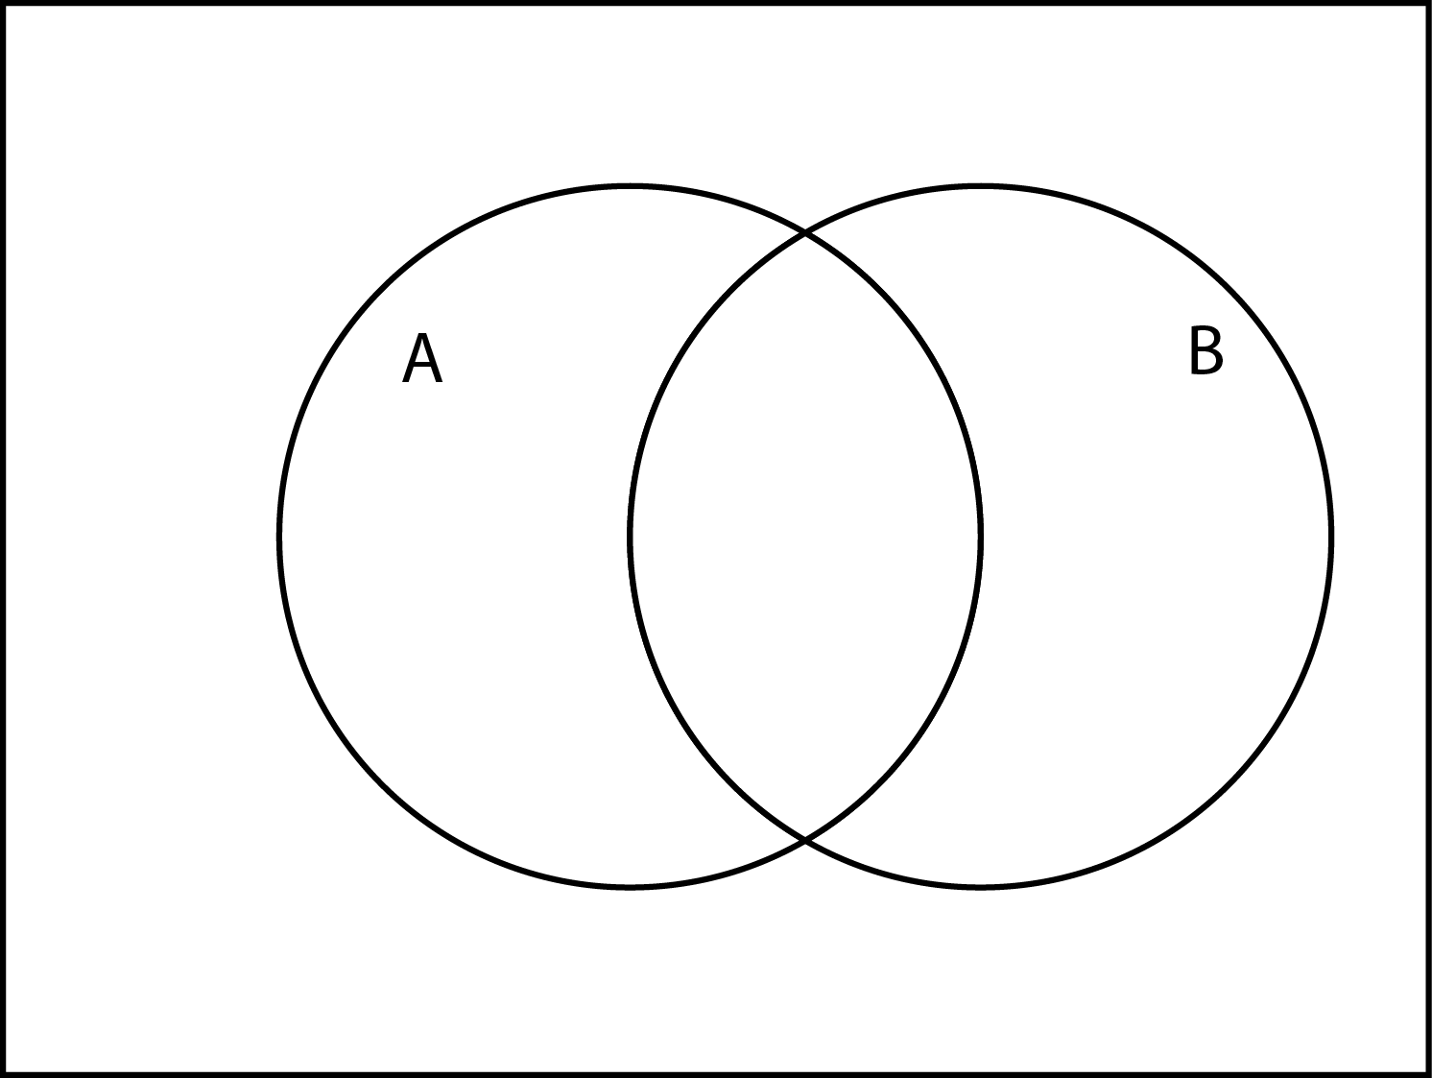
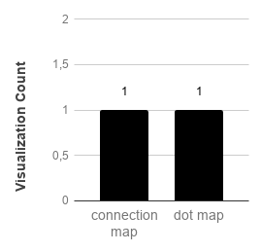

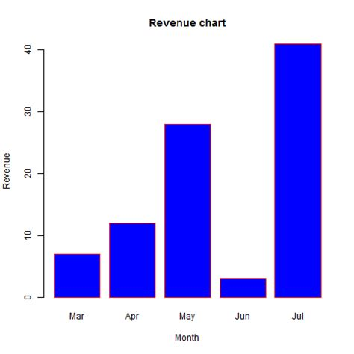
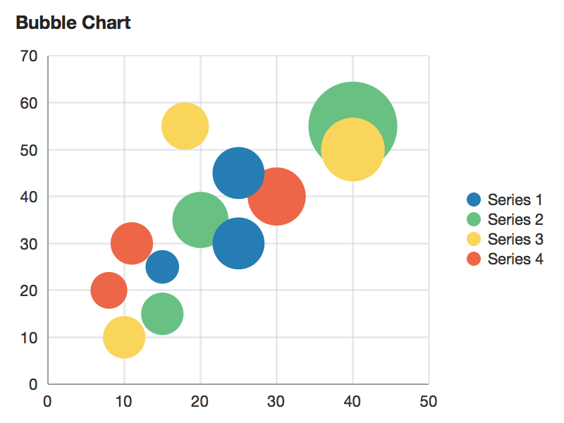
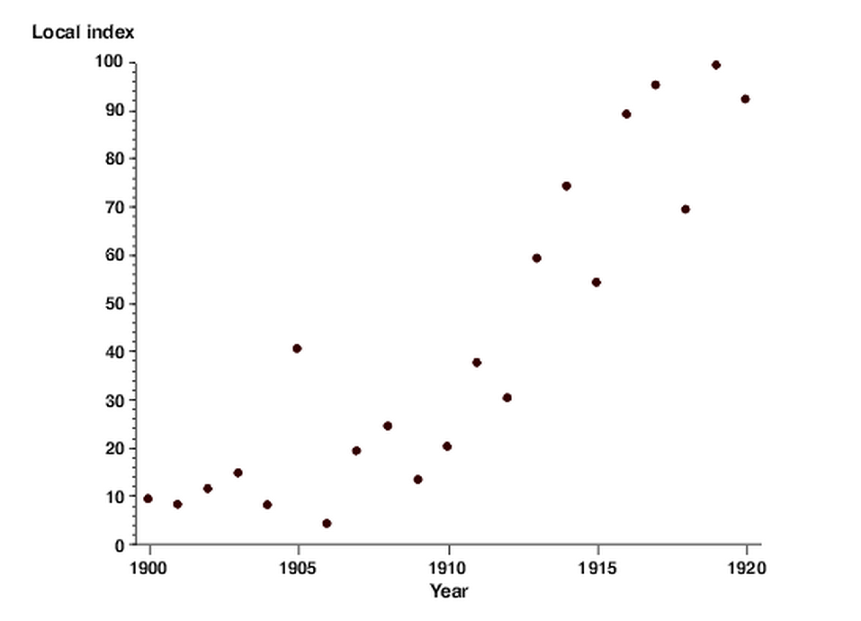
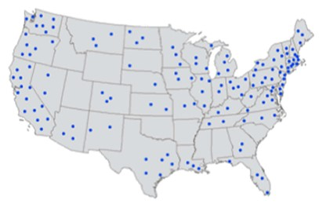
Business Ecosystem Visualization - Results
List
Timeline
Moore‘s Framework
Line Chart
Venn Diagram
Connection Map
Dot Map
Bar Chart
Bubble Chart
Scatter Plot
URLs of the images on slide 26
Notes:
Depiction of the visualization used in the literature, continued

Slide 21
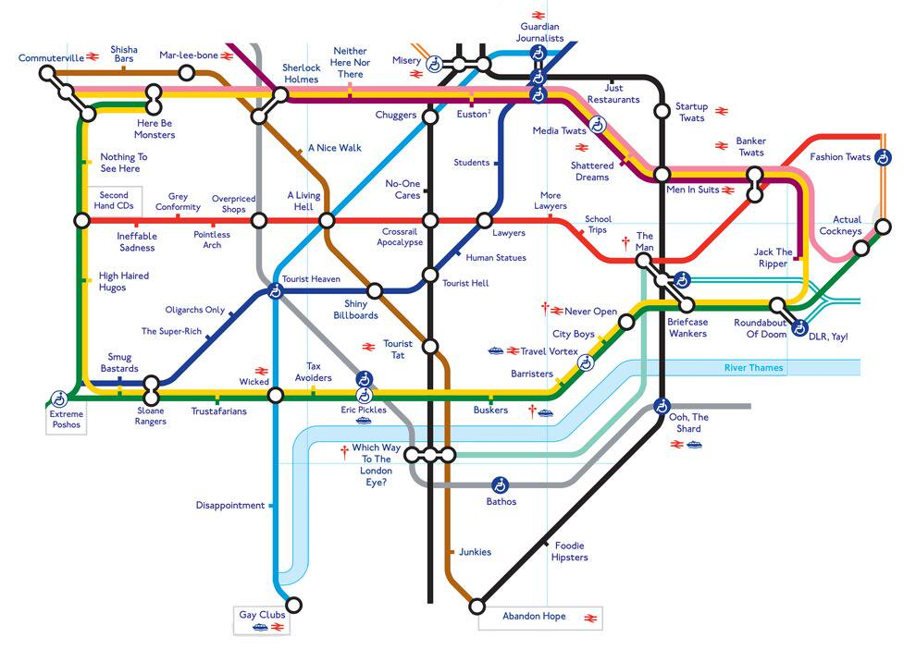
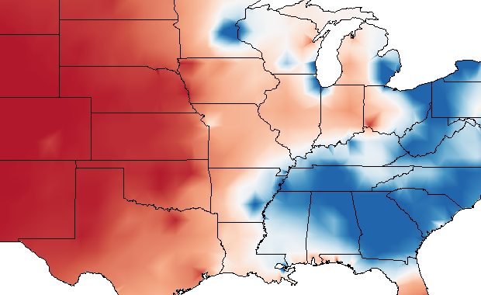
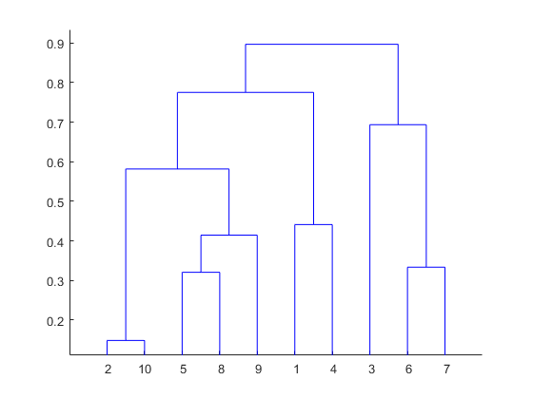
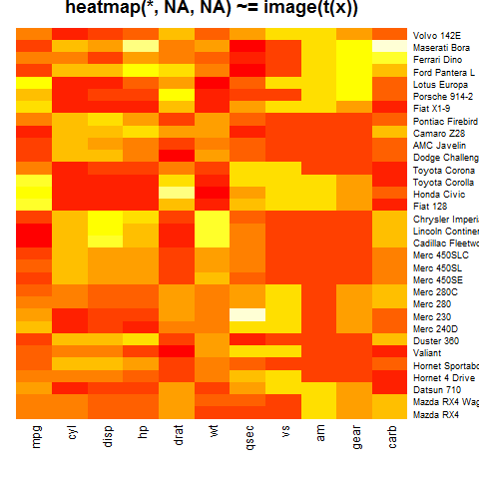

Business Ecosystem Visualization – Results
vs.
vs.
vs.
vs.
vs.
URLs of the images on slide 26
Notes:
- Some visualization within each category are more suitable than others

Slide 22
Outline
Business Ecosystems
  Motivation
  Research Questions
Business Ecosystem Theory
  Systematic Mapping Study
  Working Definition
Business Ecosystem Variations
  Types
  Structures
  Types vs. Structures
Business Ecosystem Visualization
  Approach
  Results
Summary of Results
Sources

Slide 23
Summary of Results
Properties of a Business Ecosystem
Loosely coupled network
Different roles
RQ 1
Evolution over time
Different Business Ecosystem Types
Types differ in core value
RQ 2
Structures depict evolution
RQ 3
Visualizations of Business Ecosystems
Networks most suitable
Additional information
Some visuals fit better than others

Slide 24
Outline
Business Ecosystems
  Motivation
  Research Questions
Business Ecosystem Theory
  Systematic Mapping Study
  Working Definition
Business Ecosystem Variations
  Types
  Structures
  Types vs. Structures
Business Ecosystem Visualization
  Approach
  Results
Summary of Results
Sources

Slide 25
Sources
    [1] https://www.press.bmwgroup.com/global/article/detail/T0194311EN/bmw-group-recognises-suppliers-for-best-innovations. Accessed
    February 1, 2019.
    [2] https://www.focus.de/auto/news/autoabsatz/bmw-produktion-steht-still-ohne-diese-zehn-zulieferer-laeuft-kein-auto-vom-band_id_5890987.html. Accessed February 1, 2019.
    [3] James F. Moore. The Death of Competition – Leadership & Strategy in the Age of Business Ecosystems. Harper Business, 1997.
    [4] Marco Iansiti and Roy Levien. The Keystone Advantage – What the New Dynamics of Business Ecosystems Mean for Strategy,
    Innovation, and Sustainability. Harvard Business School Press, 2004.
    [5] Ke Rong and Yongjiang Shi. Business Ecosystems: Constructs, Configurations, and the Nurturing Process. The Palgrave Macmillan,
    2014.
    [6] David Budgen, Mark Turner, Pearl Brereton, and Barbara Kitchenham. Using Mapping Studies in Software Engineering. Retrieved
    14.09.2018 from www.ebse.org.uk.
    [7] Kai Petersen, Robert Feldt, Shahid Mujtaba, and Michael Mattsson. Systematic map-ping studies in software engineering. InEASE’08 Proceedings of the 12th internationalconference on Evaluation and Assessment in Software Engineering, pages 68–77, 2008.Italy.
    [8] Barbara Kitchenham, David Budgen, and O. Pearl Breretom. Using mapping studiesas the basis for further research - a participant-observer case study.Information andSoftware Technology, 53(6):638–651, 2011.
    [9] Jane Webster and Richard T. Watson. Analyzing the Past for Prepare for the Future:Writing a Literature Review.MIS Quarterly, 26(2):xiii–xxiii, 2002.
    [10] Ben Shneiderman. The eyes have it: A task by data type taxonomy for information visualizations. In Proceedings 1996 IEEE
    Symposium on Visual Languages, pages 336– 343. Institute of Electrical and Electronics Engineers Inc., 1996.
    [11] Rahul C. Basole, Trustin Clear, Mengdie Hu, Harshit Mehrotra, and John Stasko. Understanding Interfirm Relationships in Business
    Ecosystems with Interactiv Visualizations. IEEE Transactions on Visualization and Computer Graphics, 19(12):2526–2535, 2013.
    [12] Rahul C. Basole, Arjun Srinivasan, Hyunwoo Park, and Shiv Patel. ecoxight: Discovery, Exploration, and Analysis of Business
      Ecosystems Using Interactive Visualization. ACM Transactions on Management Information Systems, 9(2), 2018.
    [13] https://ecosystem-explorer.in.tum.de/#/. Accessed February 1, 2019.

Slide 26
Sources - Visualizations
    1-dimensional visualizations:
    List: https://image.flaticon.com/icons/svg/52/52928.svg
    2-dimensional visualizations:
    Connection Map: https://cdn.slidemodel.com/wp-content/uploads/2074-01-worldmap-connections-16x9-1.jpg
    Dot Map: http://1.bp.blogspot.com/-_wTSnI2L6mU/UA8ys96r8dI/AAAAAAAAAIE/Am2JKzLz6EA/s1600/DOT+DENSITY.gif
    Isarithmetic Map: http://1.bp.blogspot.com/-CYK7W35hPrI/TlwYaBY4TXI/AAAAAAAAAAU/QJCIjtQBOds/s1600/isarithmic+map.png
    Multi-dimensional visualizations:
    Bar Chart: https://www.tutorialspoint.com/r/images/barchart_months_revenue.png
    Bubble Chart: https://docs.oracle.com/cd/E57014_01/adf/tag-reference-dvt/images/chart/bubbleChart.png
    Heat Map: http://i.stack.imgur.com/S9ghV.png
    Line Chart: https://camo.githubusercontent.com/22c2fafa60804cb2bc3f60ff8afe6d5262da3b25/68747470733a2f2f73332e61
    6d617a6f6e6177732e636f6d2f7a654d6972636f2f6769746875622f73776966742d6c696e6563686172742f30312e706e67
    Scatter Plot : http://betterevaluation.org/sites/default/files/Method.scatterplot1.png
    Venn Diagram: http://www.calendarprintabletemplates.com/wp-content/uploads/2017/08/Free-venn-diagram-template.png
    Network visualizations:
    Chord Diagram: http://jrue.github.io/assets/images/exercise_images/chorddiagram.jpg
    Directional Network: http://4.bp.blogspot.com/-f96LgjdGKsg/UUGIbxTkc-I/AAAAAAAAAJ0/gSfSNCZhPIM/s1600/force10.png
    Matrix: https://www.google.de/url?sa=i&source=images&cd=&cad=rja&uact=8&ved=2ahUKEwj4puTes-jfAhUFU1AKHVHuApEQjRx6BAgBEAU&url=https%3A%2F%2Fen.wikipedia.org%2Fwiki%2FAdjacency_matrix&psig=AOvVaw3cQI_3VTjE9Ffxj9h0mVQ_&ust=1547387988931601
    Node Network: https://brettworks.files.wordpress.com/2011/12/network3.jpeg
    Tube Map: http://www.thepoke.co.uk/wp-content/uploads/2016/06/BhjWyQ7CYAAGZsP.jpg
    Temporal visualizations:
    Arc Diagram: http://datavizproject.com/wp-content/uploads/2016/06/DVP_1_100-68.png
    Timeline: https://images.template.net/wp-content/uploads/2015/07/Timeline-Infographic-Business-Sample-5.jpg
    Tree visualizations:
    Dendogram: https://www.mathworks.com/help/examples/stats/win64/PlotDendrogramExample_01.png
    Hyperbolic Tree: http://www.flong.com/storage/experience/bubba/hyptree.gif
    Sunburst Diagram: http://datavizproject.com/wp-content/uploads/2015/10/DVP-30.png
    Tree Map: https://www.thinkoutsidetheslide.com/wp-content/uploads/2013/09/treemap.png
Last accessed January 14, 2019

Slide 27
Maximilian Riemhofer
17132
maximilian.riemhofer@tum.de

